Slide 1
Microsoft SQL Server 2012
Integration Services (SSIS)

Slide 2
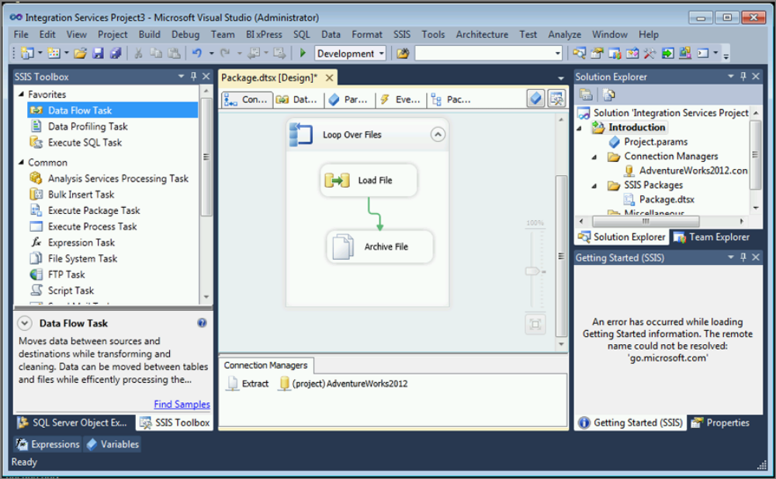
SQL Server Data Tools (SSDT)
  the central tool that you’ll spend most of your time in as an SSIS developer
  the tool’s foundation is the Visual Studio 2010 interface

Slide 3
SSIS
extraction, transformation and loading (ETL) platform
major player in the ETL market
package
  a core component of SSIS
  collection of tasks that execute in an orderly fashion
task
  an individual unit of work

Slide 4
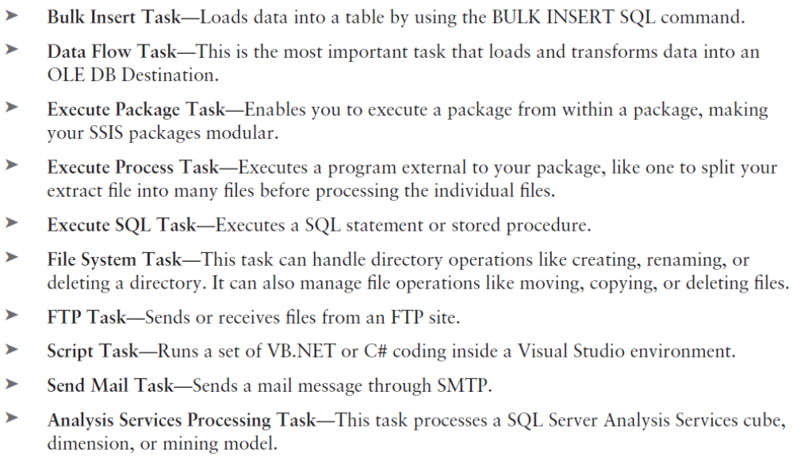
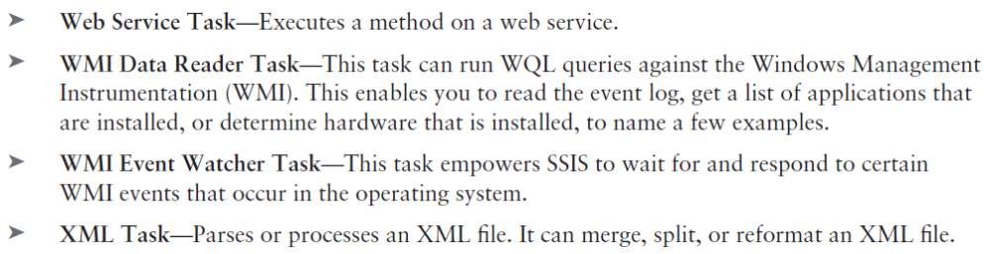
Tasks

Slide 5
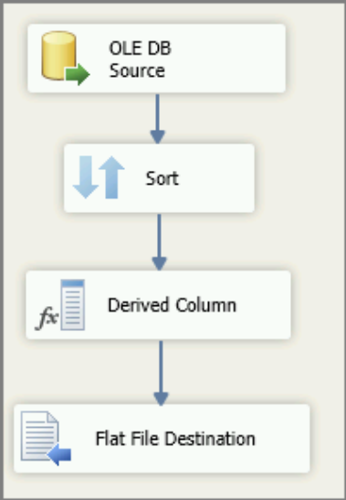
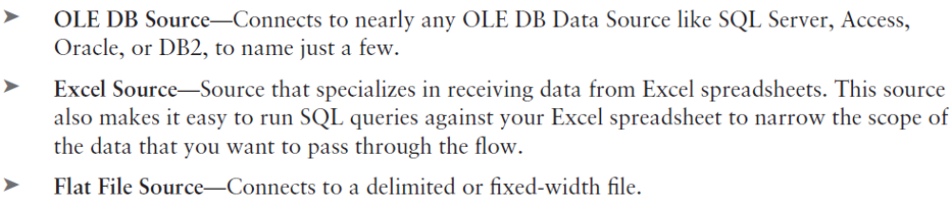
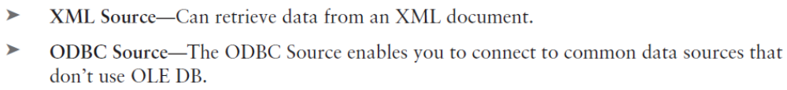
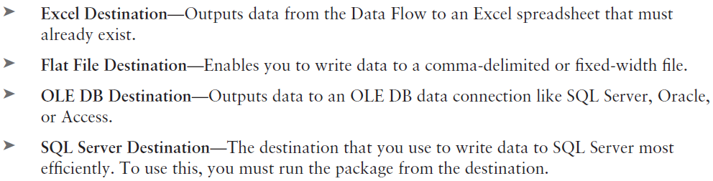
Data Flow Elements
Source
Destination

Slide 6
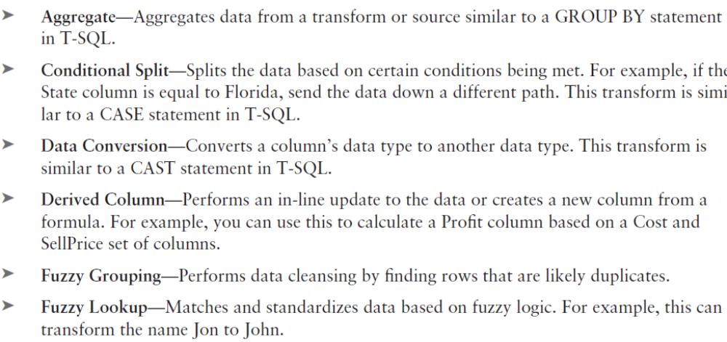
Data Flow Elements
Transformations

Slide 7
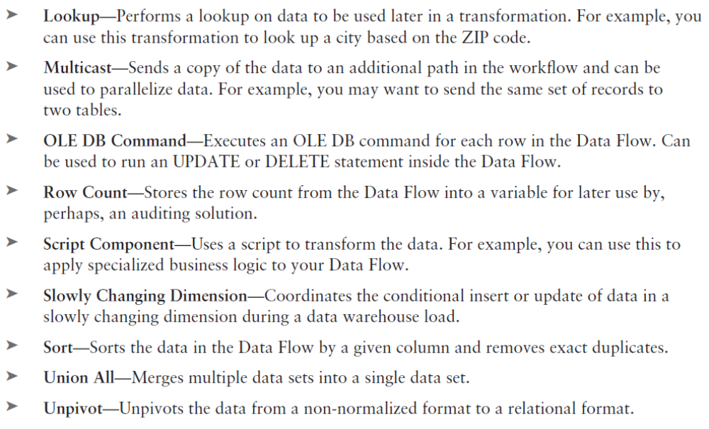
Data Flow Elements
More transformations..

Slide 8
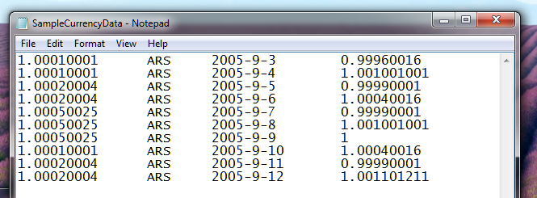
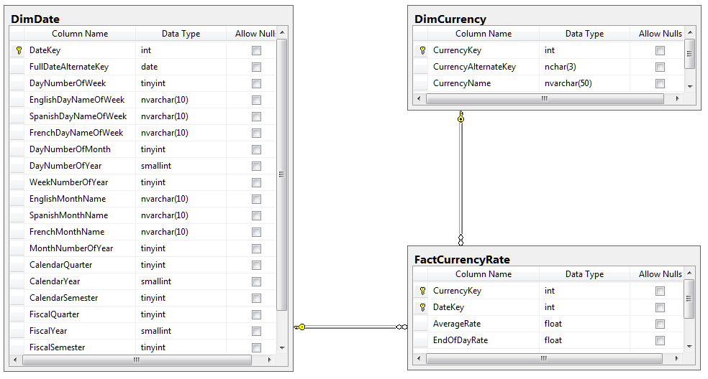
SSIS - demo
AverageRate
CurrencyID
CurrencyDate
EndOfDayRate

Slide 9
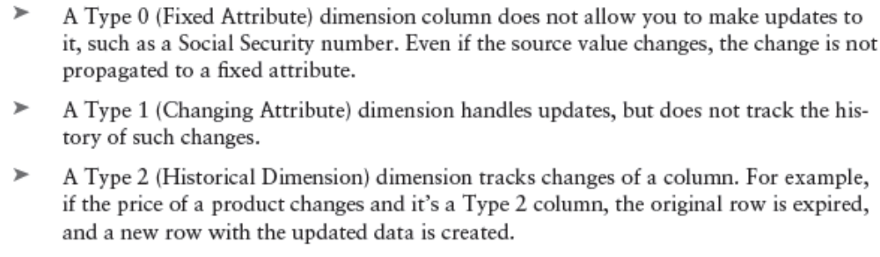
Dimension Load
Slowly Changing Dimension (SCD) Wizard is a Data Flow object that takes all the complexity out of creating a load process for your dimension table.

Slide 10
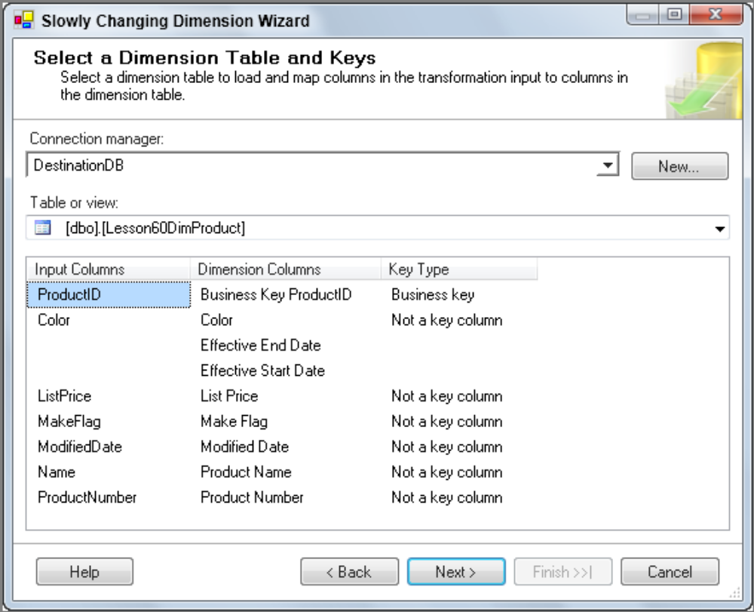
Dimension Load

Slide 11
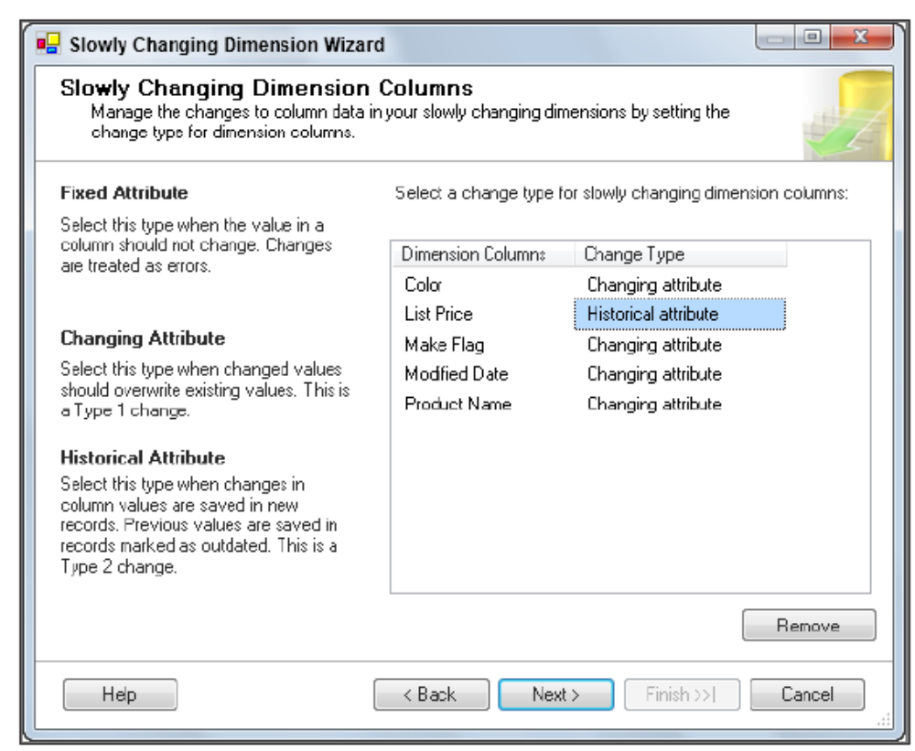
Dimension Load

Slide 12
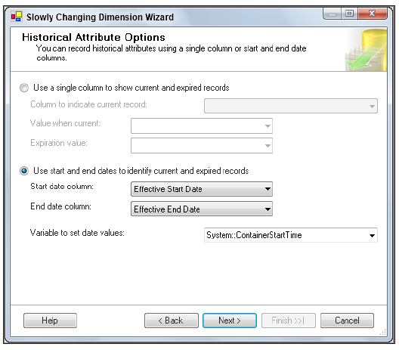
Dimension Load

Slide 13
Bibliography
Brian Knight, Devin Knight, Mike Davis, Wayne Snyder, Microsoft SQL Server 2012 Integration Services, 2012
Francis Rodrigues, Michael Coles, Davd Dye, Pro SQL Server 2012 Integration Services, APRESS 2012
Brian Knight, Erik Veerman, Jessica M. Moss, Mike Davis, Chris Rock, PROFESSIONAL Microsoft SQL Server 2012 Integration Services, Wiley 2012

